Slide 1
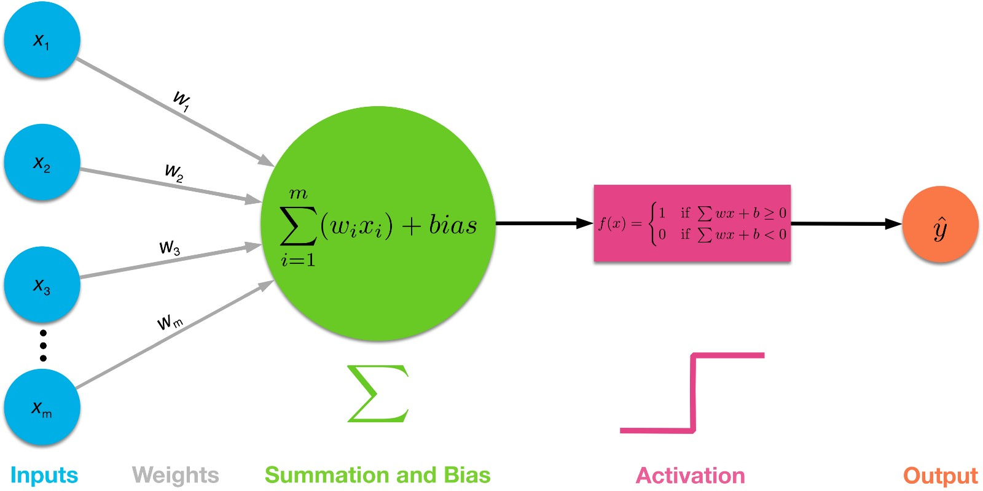
Perceptron
Procedures of a Single-layer Perceptron Network

Slide 2
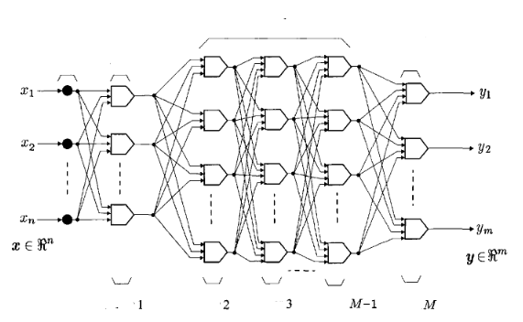
Multilayer perceptron Daugelio sluoksnių neuroninis tinklas

Slide 3
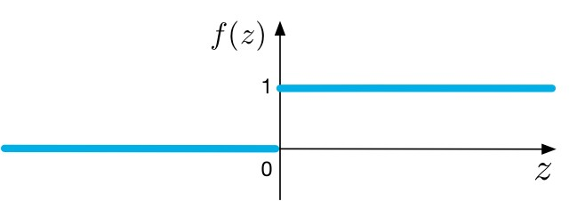
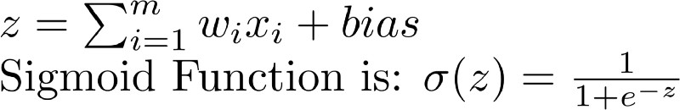
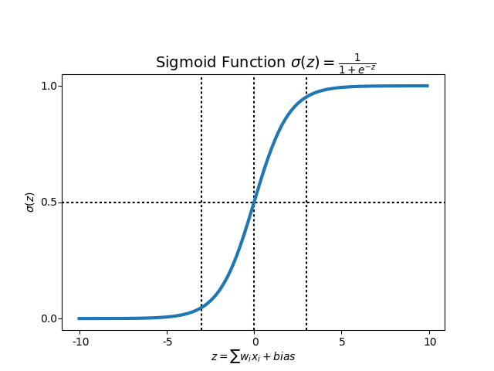
Sigmoid Neurons
Step Function

Slide 4
Sigmoid function produces similar results to step function in that the output is between 0 and 1. The curve crosses 0.5 at z=0, which we can set up rules for the activation function, such as: If the sigmoid neuron’s output is larger than or equal to 0.5, it outputs 1; if the output is smaller than 0.5, it outputs 0.

Slide 5

MNIST dataset of Hand-written Digits.

Slide 6
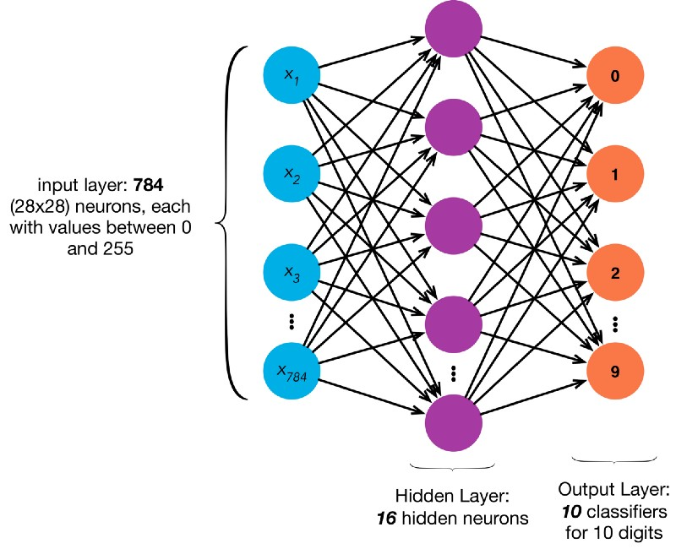
Multi-Layer Sigmoid Neural Network with 784 input neurons, 16 hidden neurons, and 10 output neurons

Slide 7
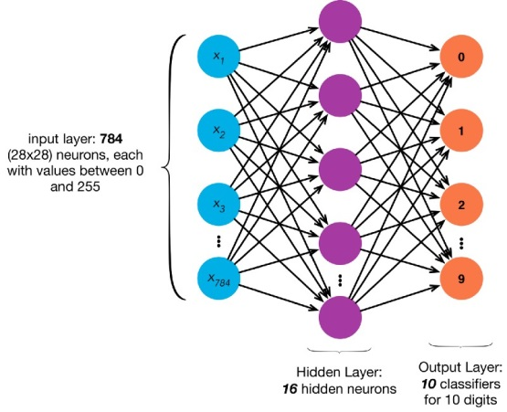
It has 784 input neurons for 28x28 pixel values. Let’s assume it has 16 hidden neurons and 10 output neurons.
The 10 output neurons, returned to us in an array, will each be in charge to classify a digit from 0 to 9.
So if the neural network thinks the handwritten digit is a zero, then we should get an output array of [1, 0, 0, 0, 0, 0, 0, 0, 0, 0], the first output in this array that senses the digit to be a zero is “fired” to be 1 by our neural network, and the rest are 0.
If the neural network thinks the handwritten digit is a 5, then we should get [0, 0, 0, 0, 0, 1, 0, 0, 0, 0]. The 6th element that is in charge to classify a five is triggered while the rest are not. So on and so forth.

Slide 8
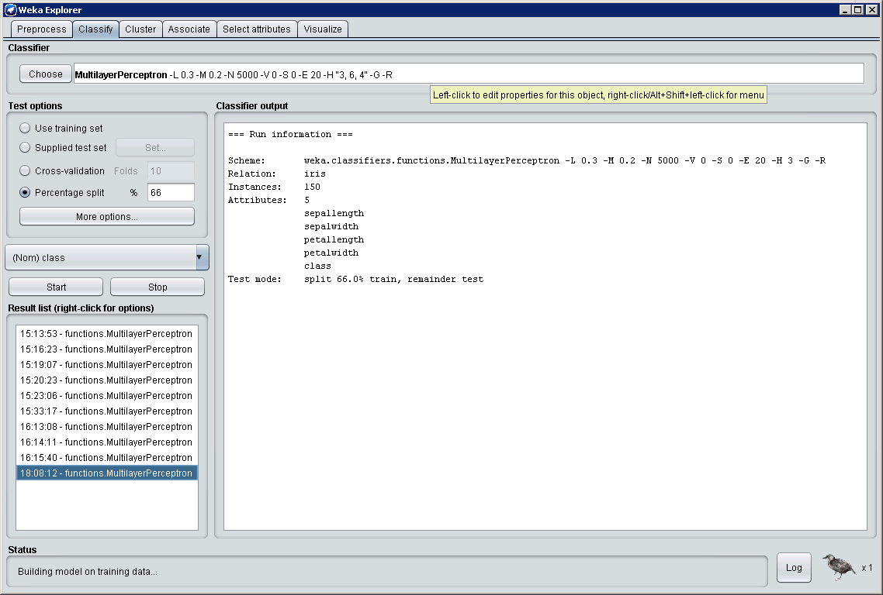
Weka
Double click

Slide 9
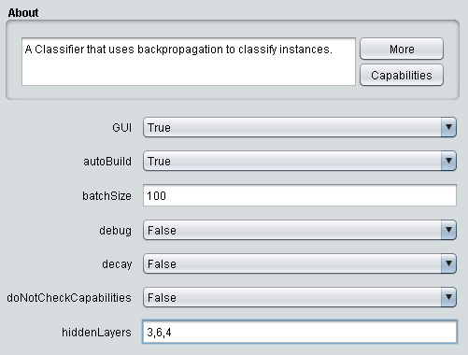
Weka
Change to True
Means: first hidden layer 3 neurons , second – 6, third - 4

Slide 10
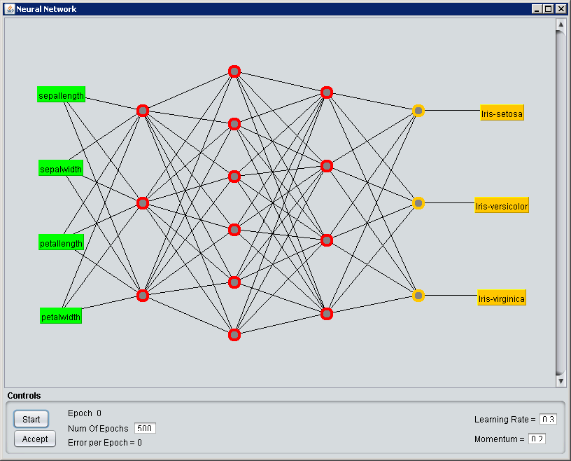
Weka

Slide 11
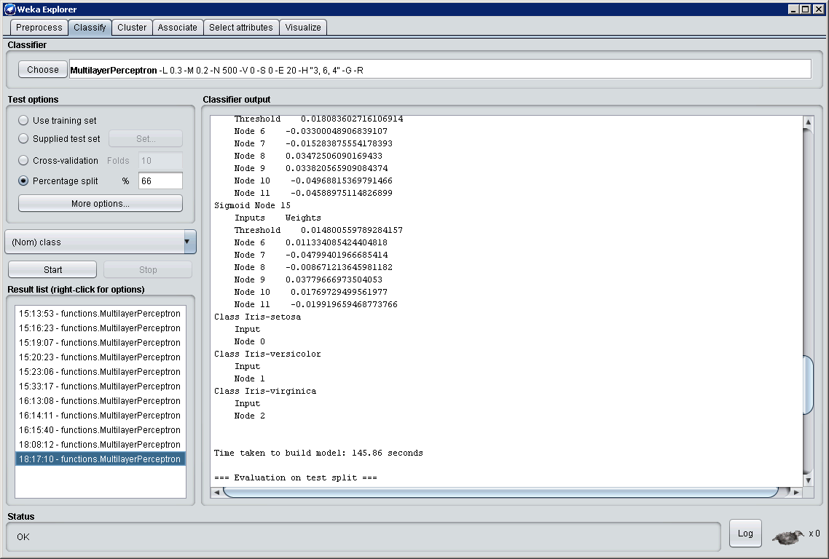
Weka: Why is there threshold?
Because sigmoid is defined as
sigmoid(w,x,b) = 1/(1+exp(-(<w,x>-b)))

Slide 12
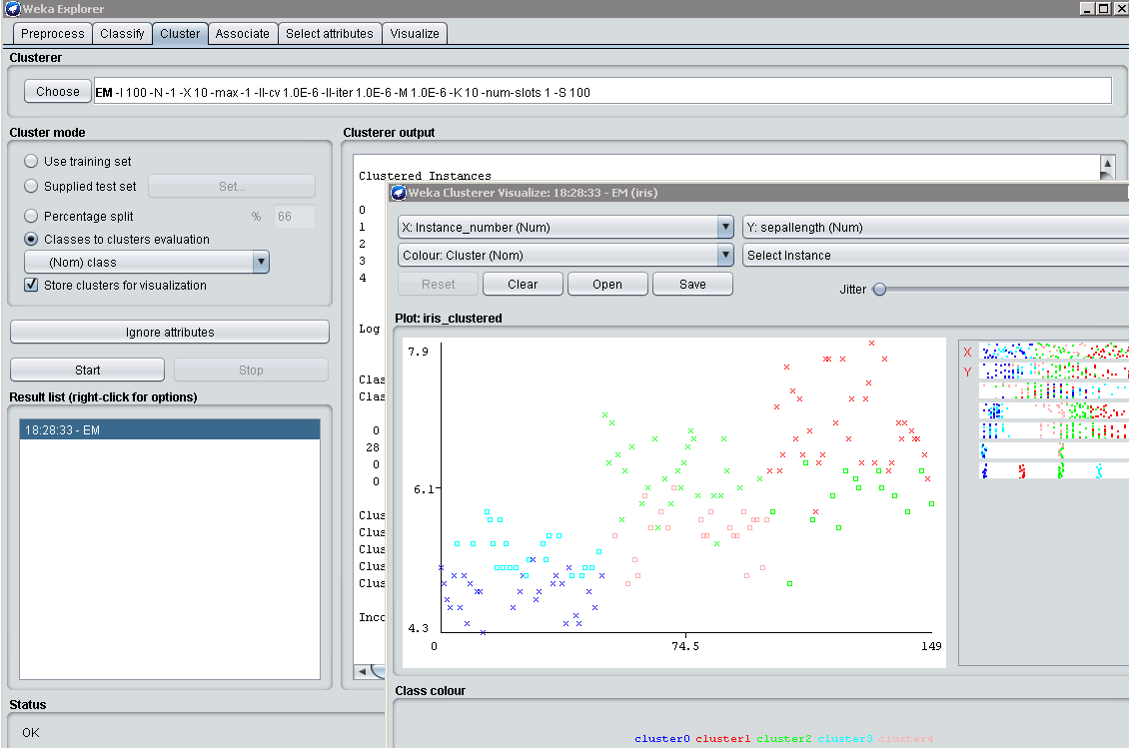
Weka: klasterių paieška

Slide 13
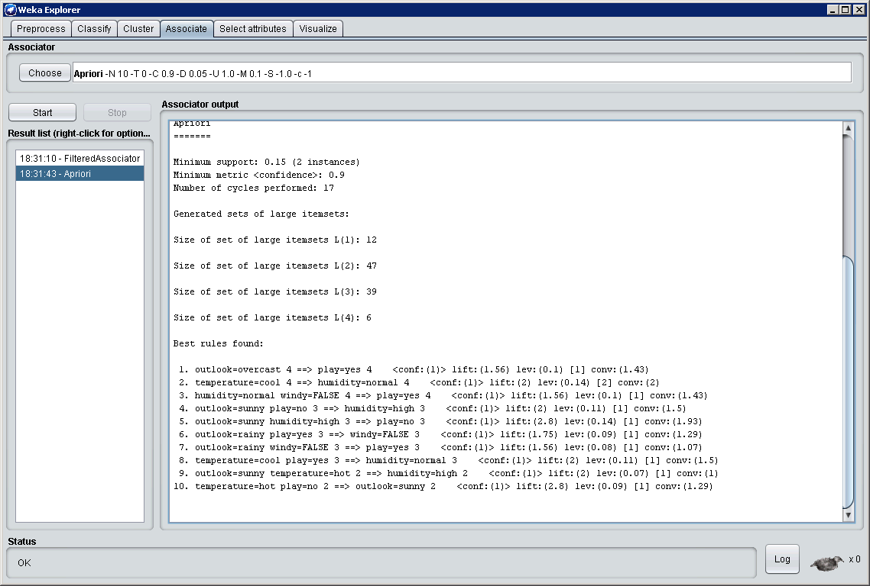
Weka: asociacijs taisyklių paieška

Slide 14
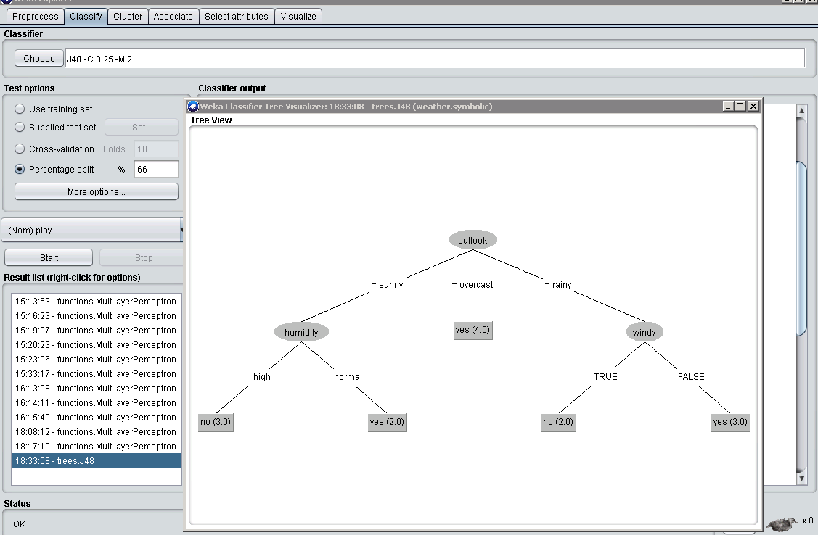
Weka: sprendimų medis

Slide 16
The Microsoft Cognitive Toolkit (CNTK)
Setup CNTK on your machine:

Slide 17
0. MKL
The default CNTK math library is the Intel Math Kernel Library (Intel MKL). Follow this page to install it in your system.
Prepend its path to environment variable PATH, e.g.:
setx PATH "c:\local\mklml-2018.0.1\lib;%PATH%"

Slide 18
1. Installing CNTK for Python on Windows Anaconda3
We have been testing CNTK with Anaconda3 4.1.1 (64-bit) and Python versions 2.7 and 3.5, as well as Anaconda3 4.3.1 with Python version 3.6. If you do not have a Anaconda3 Python installation, install Anaconda3 4.1.1 Python for Windows (64-bit).

Slide 19
2. First time CNTK installation
If this is the first time you install CNTK then run
C:\> pip install <url>
Tai yra CPU-Only
pip install https://cntk.ai/PythonWheel/CPU-Only/cntk-2.5-cp35-cp35m-win_amd64.whl

Slide 20
3. Quick installation test
A quick test that the installation succeeded can be done by querying the CNTK version:
python -c "import cntk; print(cntk.__version__)"

Slide 21
4. Testing your CNTK install with Python
CD CNTK-Samples-2-5
cd Tutorials
cd NumpyInterop
python FeedForwardNet.py

Slide 22
5. Run Jupyter notebooks
cd Tutorials
jupyter notebook

Slide 23
CNTK 101: Logistic Regression and ML Primer

